Slide 1
Loops and Condition using class and functional alternatively
Salman Ahmed G

Slide 2
Conditional operator
You can add conditional operator in JSX to make decision for outpout.
(condition)?true:false
Condition you can use the state variable to decide the true condition.
Inside true you can have a block of html code inserted in the first block
Inside false you can have block of html or null to show empty otherwise

Slide 3
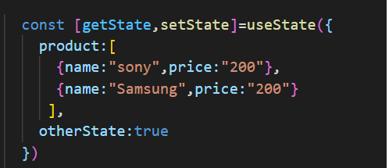
Example – add boolean state

Slide 4
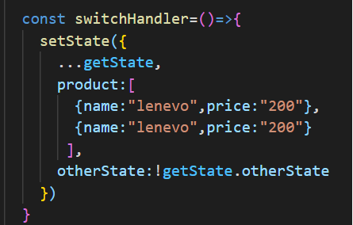
Example – update state

Slide 5
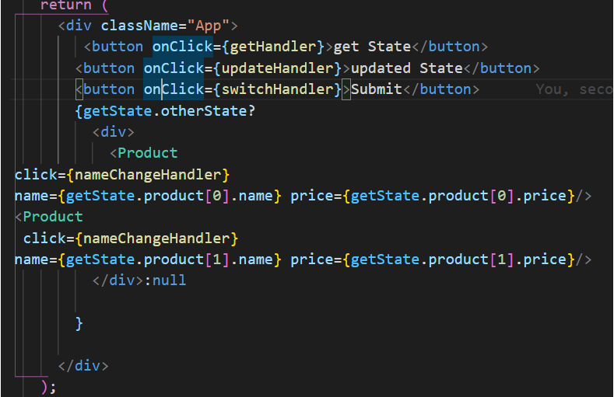
Example – ternary operator

Slide 6
Different approach for adding condition
We can declare one variable and then we can bind the value on it depends on the condition.
In example we have given person as variable and initial value is null.
During initial DOM render it will show empty
Once the state is updated then person will get value on it and it will be render in the DOM.

Slide 7
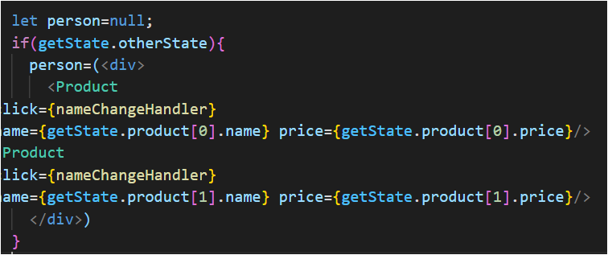
EXAMPLE-1

Slide 8
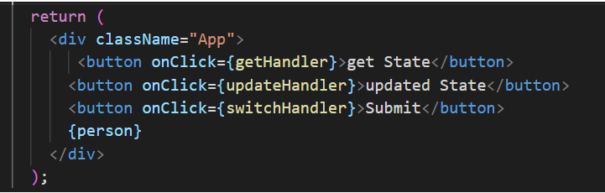
EXAMPLE-2

Slide 9
Loop Inside jsx
To loop the data inside JSX we need to use map function
Inside each render of map data we need to have key property
Key property can be index from map function or any unique key that can be generated from frontend or backend
If data is empty map will not executed anything
Map function support will array

Slide 10
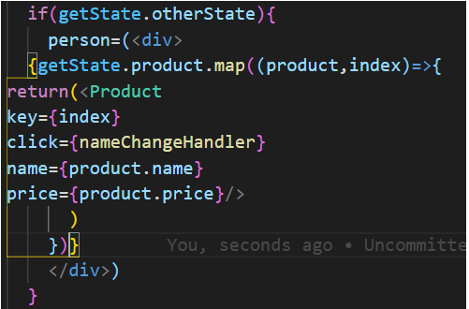
Example – map function

Slide 11
Event called inside map function
Any events can be called inside the map function as well.
To differentiate between data we need to pass index value during event call.
Then you can call state to update for tht

Slide 12
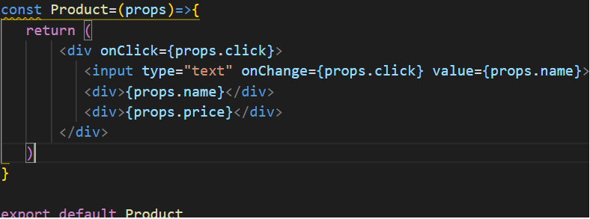
Example – 1 – onclick event

Slide 13
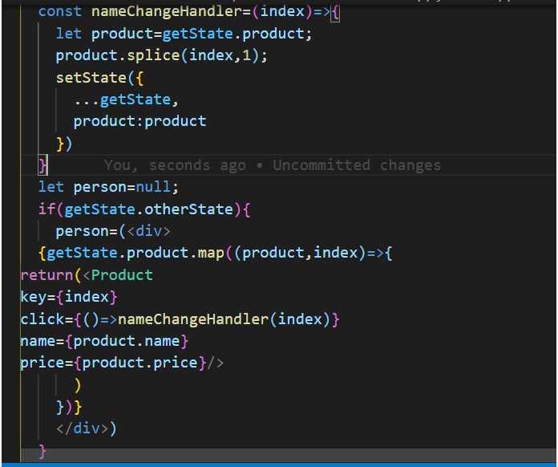
Example -2 - setstate

Slide 14
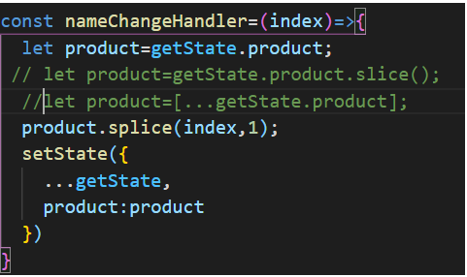
Example -3 setstate better approach

